Slide 1

Chance and Data
Interpret data
Infer population statistics
Confidence interval and level
Sample size

Slide 2
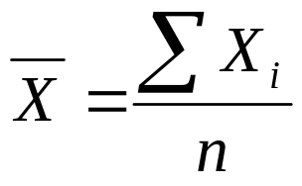
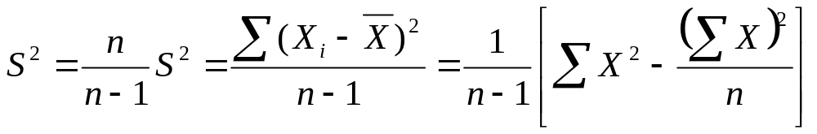
Estimation
Estimate is a specific value or quantity obtained for a statistic such as sample mean or sample variance.
There are two types of estimation:
Point estimation (specific value)
Single number used to estimate a population parameter
Point estimate of population mean:
Point estimate of population variance:
Interval estimation (range of values)

Slide 3
Central Limit Theorem
According to central limit theorem, as the sample size, n, increases,
The distribution of sample means approaches a normal distribution
The mean of the sample means, approaches the population mean
The standard deviation of the sample means approaches σ/√n, where σ is the standard deviation of the population

Slide 4
Interval Estimation
Interval estimate (confidence interval) is a two numbers between which the population parameter may be considered to lie
Interval estimate indicates the accuracy of an estimate
Level of confidence (confidence coefficient) refers to levels of certainty in which the interval estimate is correct
e.g: confidence level of 95% shows that 95% confident that the interval contains the parameter that is being estimated.

Slide 5
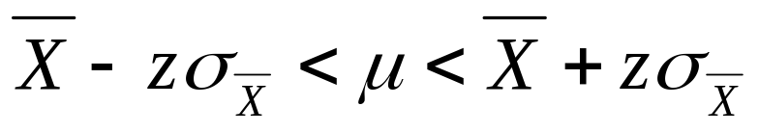
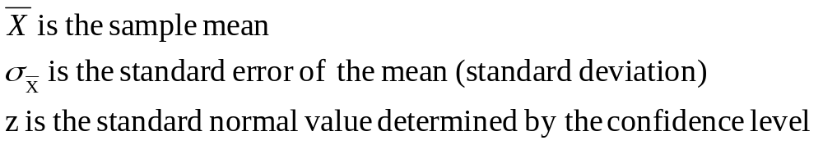
Interval Estimation
Critical value is the z-value in the confidence interval. It is obtained for different levels of confidence
An interval estimate of μ (population mean):
where
Lower limit of estimate
Upper limit of estimate

Slide 6
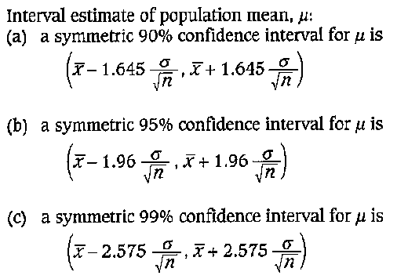
Interval Estimation

Slide 7
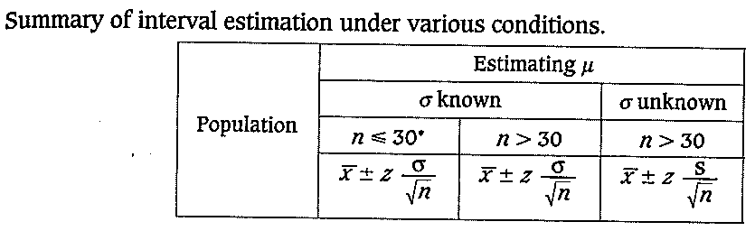
Interval Estimation
* Population is assumed to be normally distributed

Slide 8
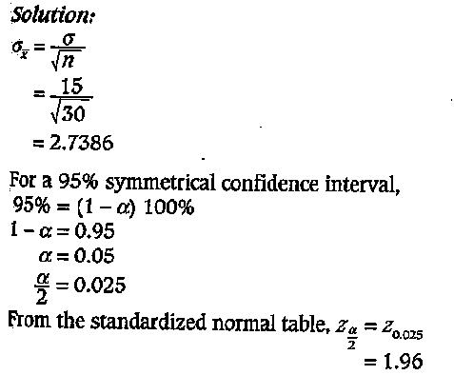
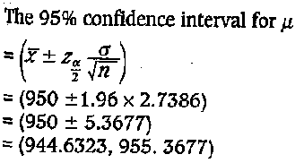
Example Interval Estimation
Estimate the population mean at the 95% confidence
levels, where the sample mean is 950, the σ is 15 and the
sample size is 30.

Slide 9
Calculate the sample size
The height of a random sample of 36 students shows
that mean sample is 174.5cm and s is 6.9cm.
(a) Construct an interval estimate with a confidence level 95%
(b) If the sample mean is to be ±2cm from the population mean with confidence level 95%, how big is the required sample?

Slide 10
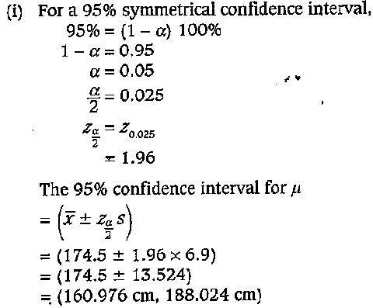
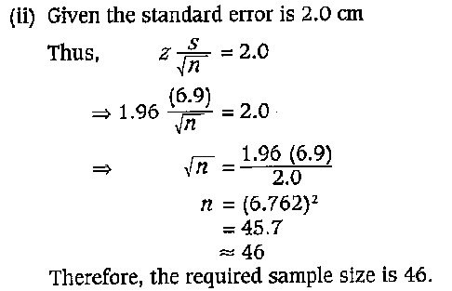

Slide 11
Questions
A school principal asks the school’s mathematics club’s advisors to estimate the average age of the students in their school. How large a sample is necessary? The advisor would like to be 99% confident that the estimate should be accurate within one year. From a previous study, the standard deviation of the ages is known to be 3 years.
A study of 40 teachers showed that they spent, on average, 12.6 minutes correcting a student’s year end examination paper. Find the 90% confidence interval of the mean time for all the papers when σ = 2.5 minutes. If a teacher stated that he spent, on average, 30 minutes correcting a year end exam paper, what would be your reaction?
[ans: 1) 60, 2) (11.9, 13.3)]

